Slide 1


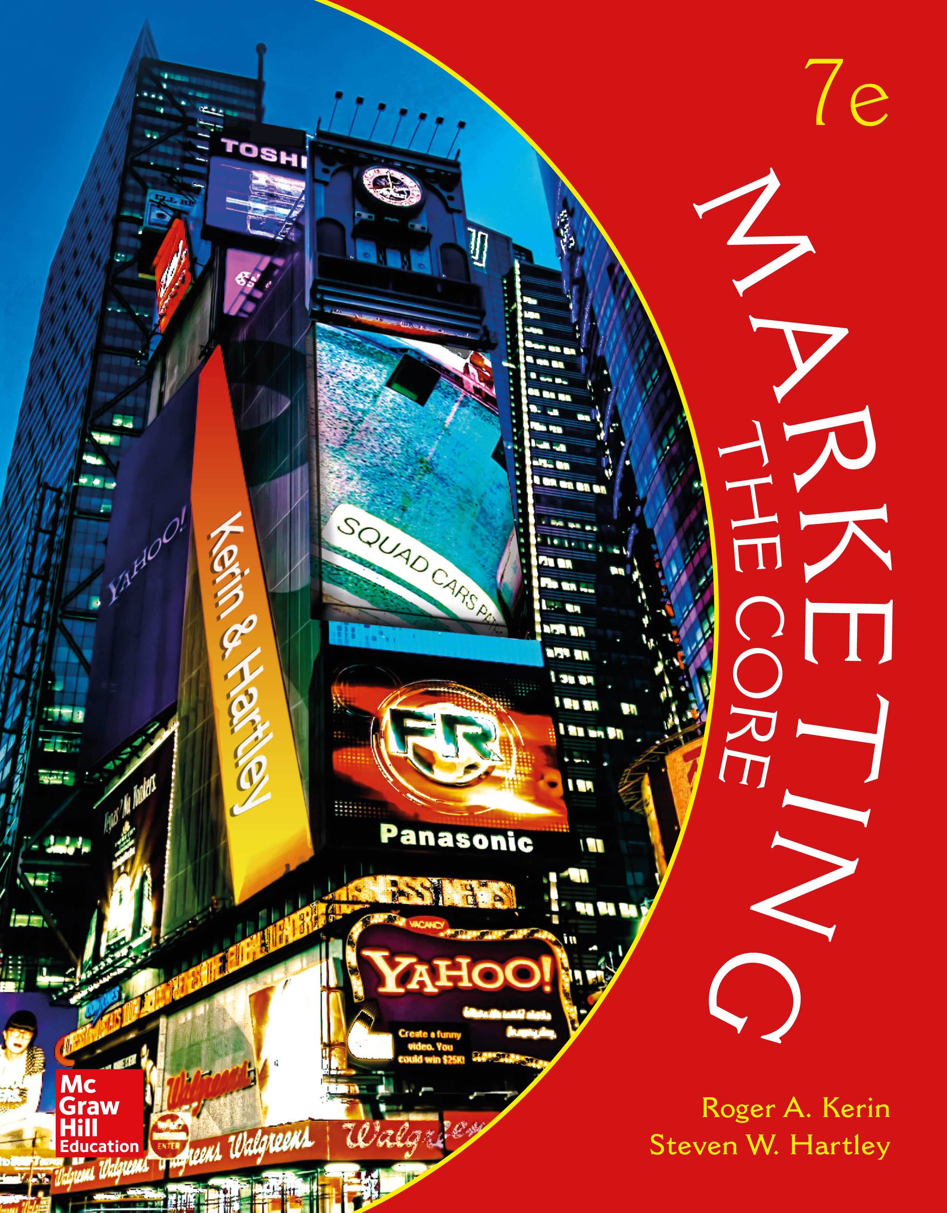
Market Segmentation, Targeting, and Positioning

Slide 2
LEARNING OBJECTIVES (LO) AFTER READING CHAPTER 8, YOU SHOULD BE ABLE TO: (1 of 2)
1. Explain what market segmentation is and when to use it.
2. Identify the five steps involved in segmenting and targeting markets.
3. Recognize the bases used to segment consumer and organizational (business) markets.

Slide 3
LEARNING OBJECTIVES (LO) AFTER READING CHAPTER 8, YOU SHOULD BE ABLE TO: (2 of 2)
4. Develop a market-product grid to identify a target market and recommend resulting marketing actions.
5. Explain how marketing managers position products in the marketplace.

Slide 4


WHY SEGMENT MARKETS? WHAT MARKET SEGMENTATION MEANS
Market Segmentation
Market Segments
Product Differentiation
Segmentation: Linking Needs to Actions
The Zappos Segmentation Strategy
Zappos
Website

Slide 5
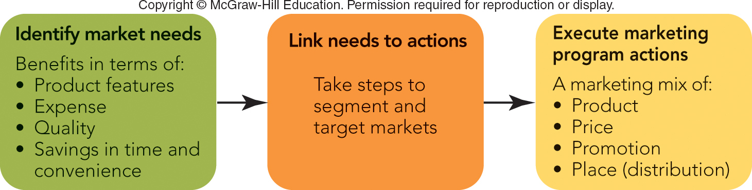
FIGURE 8-1 Market segmentation links market needs to an organization’s marketing program through marketing mix actions.
Jump to Appendix 1 long image description

Slide 6
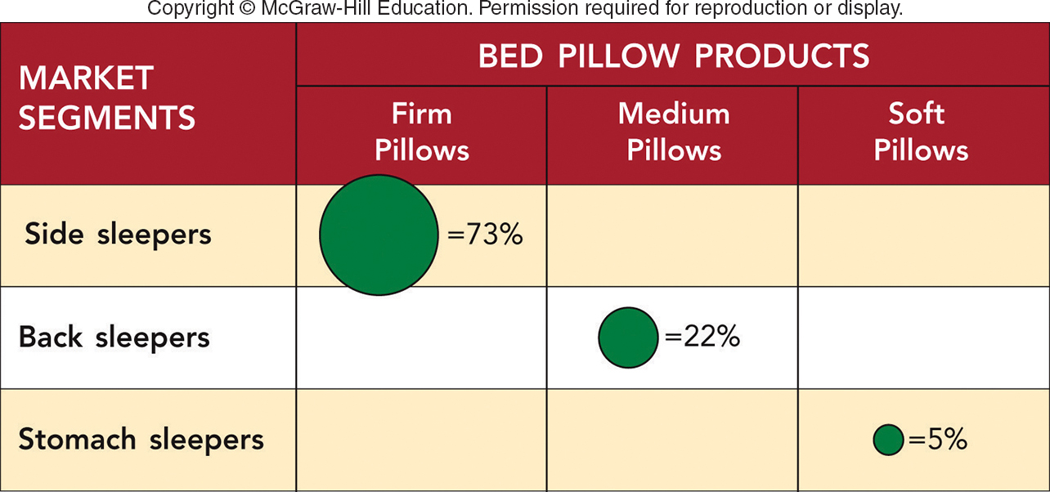
FIGURE 8-2 A market-product grid shows the kind of sleeper that is targeted for each of the bed pillows with a different firmness.
Using Market-Product Grids
Jump to Appendix 2 long image description

Slide 7
WHY SEGMENT MARKETS? WHEN AND HOW TO SEGMENT MARKETS (1 of 2)
One-Size-Fits-All Mass Markets No Longer Exist
Three Segmentation Strategies:
One Product and Multiple Market Segments (Ex: Books)
Multiple Products and Multiple Market Segments (Ex: Cars)
Segments of One–“Mass Customization” (Ex: Tailor Products to Individuals)

Slide 8
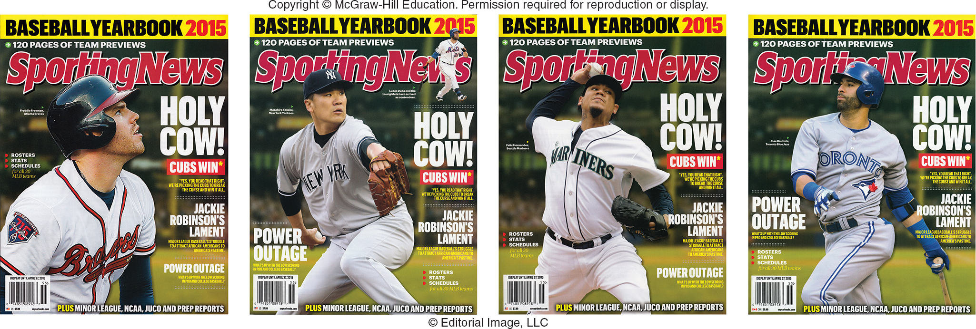
Sporting News Baseball Yearbook What market segmentation strategy is used?
Sporting News Baseball
Yearbook Website
Jump to Appendix 3 long image description

Slide 9
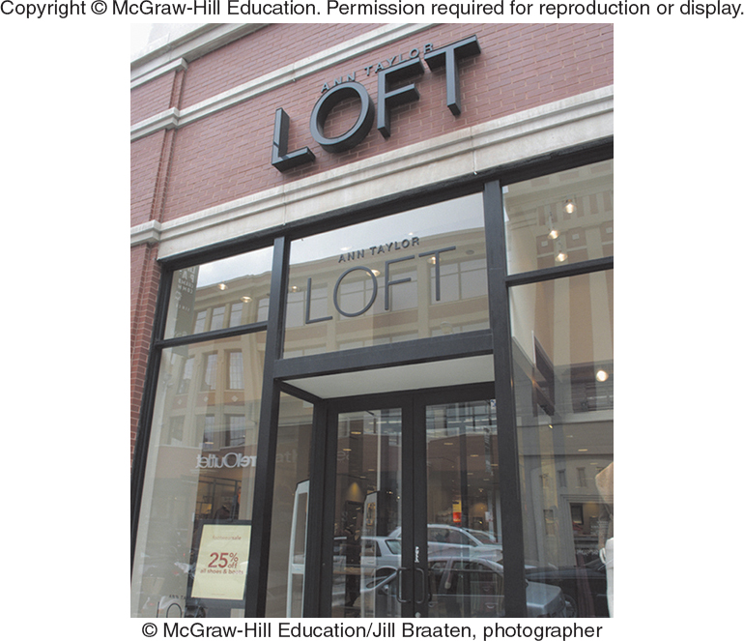
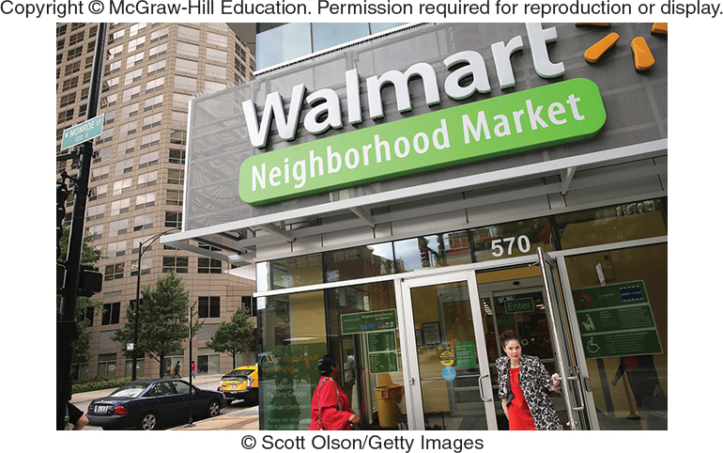
WHY SEGMENT MARKETS? WHEN AND HOW TO SEGMENT MARKETS (2 of 2)
The Segmentation Tradeoff: Synergies vs. Cannibalization
Organizational Synergy
Cannibalization
“Tiffany/Walmart” Strategies (2-Tier)

Slide 10
SEGMENTING AND TARGETING MARKETS STEP 1: GROUP POTENTIAL BUYERS INTO SEGMENTS (1 of 5)
Criteria to Use in Forming the Segments
Similarity of Needs of Potential Buyers within a Segment
Potential for Increased Profit
Difference of Needs of Buyers among Segments

Slide 11
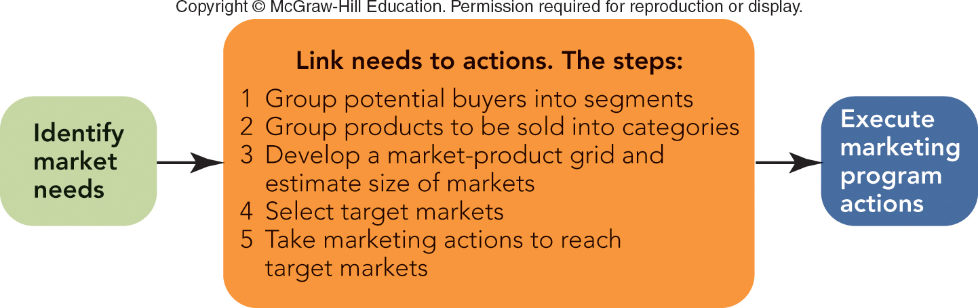
FIGURE 8-3 The five key steps in segmenting and targeting markets that link market needs to a firm's marketing program.
Jump to Appendix 4 long image description

Slide 12
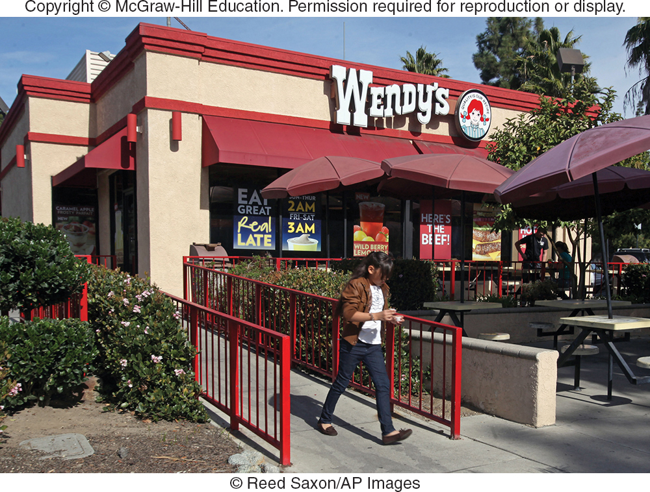
SEGMENTING AND TARGETING MARKETS STEP 1: GROUP POTENTIAL BUYERS INTO SEGMENTS (2 of 5)
Criteria to Use in Forming the Segments
Simplicity and Cost-Effectiveness
Potential for Increased Profit
Similarity of Buyers’ Needs
Difference of Needs of Buyers
Potential of Reaching Segment

Slide 13
SEGMENTING AND TARGETING MARKETS STEP 1: GROUP POTENTIAL BUYERS INTO SEGMENTS (3 of 5)
Ways to Segment Consumer Markets:
Geographic Segmentation: Region (88%)
Behavioral Segmentation: Product Features (65%)
Demographic Segmentation: Household Size (53%)
Psychographic Segmentation: Lifestyle (43%)
Usage Rate: The 80/20 Rule

Slide 14
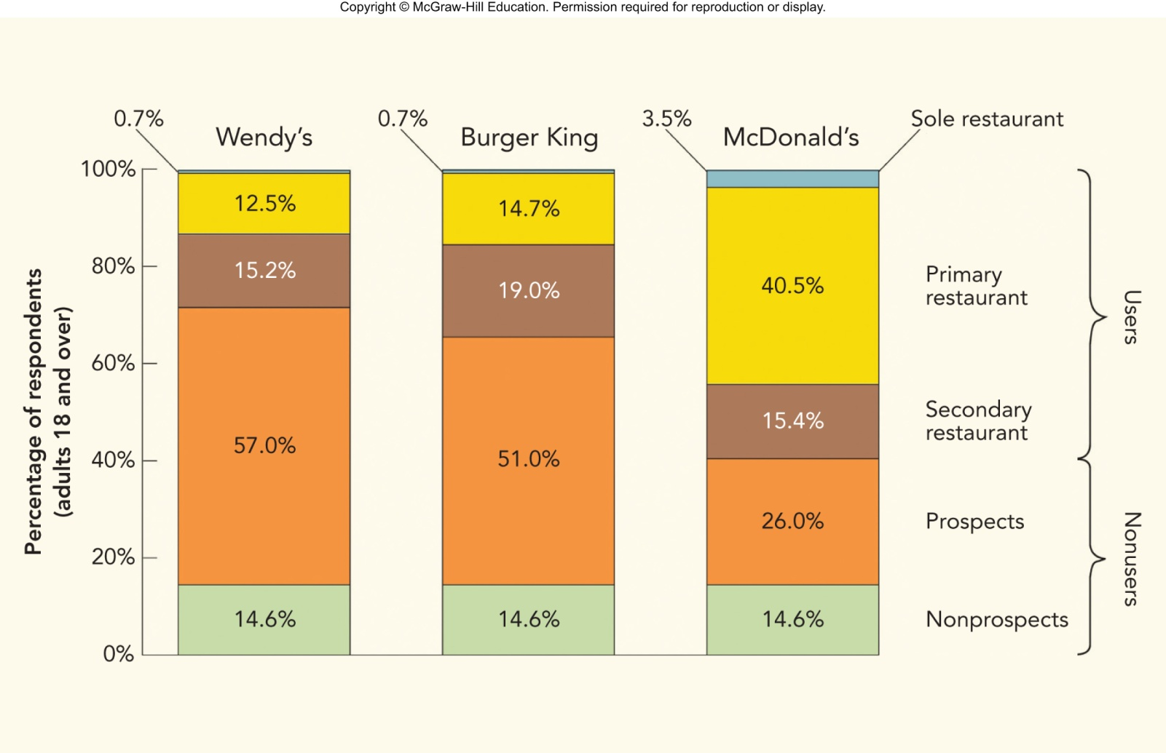
FIGURE 8-4 Comparison of various kinds of users and nonusers for Wendy’s, Burger King, and McDonald’s fast-food restaurants.
Source: Experian Marketing Services Simmons Winter 2013 Full Year Adult Survey 12-Month OneViewSM Crosstabulation Report: Based on Visits within the Past 30 Days
Jump to Appendix 5 long image description

Slide 15
SEGMENTING AND TARGETING MARKETS STEP 1: GROUP POTENTIAL BUYERS INTO SEGMENTS (4 of 5)
Variables to Use in Forming Segments for Wendy’s
Students:
Dorms, Sororities, and Fraternities
Apartments
Day Commuters
Night Commuters
Nonstudents:
Faculty and Staff
Residents in Area
Workers in Area

Slide 16
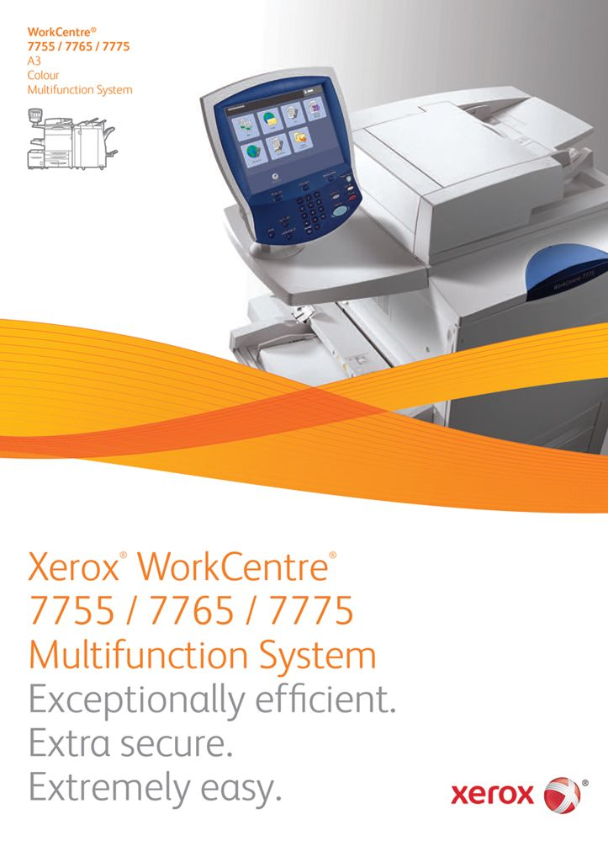
SEGMENTING AND TARGETING MARKETS STEP 1: GROUP POTENTIAL BUYERS INTO SEGMENTS (5 of 5)
Ways to Segment Organizational Markets
Geographic Segmentation: Statistical Area
Demographic Segmentation:
By NAICS Code
By Number of Employees
Behavioral Segmentation: Usage Rate

Slide 17
SEGMENTING AND TARGETING MARKETS STEP 2: GROUP PRODUCTS INTO CATEGORIES
Individual Wendy’s Products
Groupings of Wendy’s Products: Meals
Breakfast
Lunch
Between Meal Snack
Dinner
After Dinner Snack
Wendy’s Ad

Slide 18
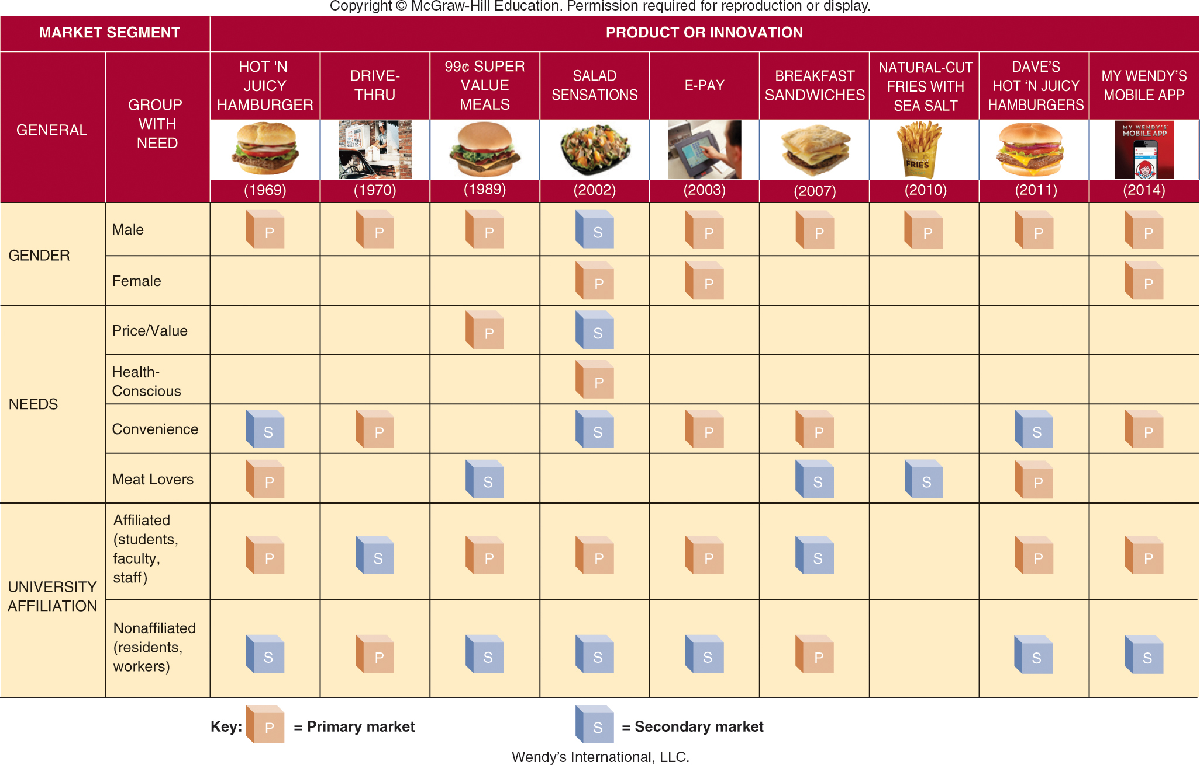
FIGURE 8-5 Wendy’s new products and innovations target specific market segments based on a customer’s gender, needs, or university affiliation.
Jump to Appendix 6 long image description

Slide 19
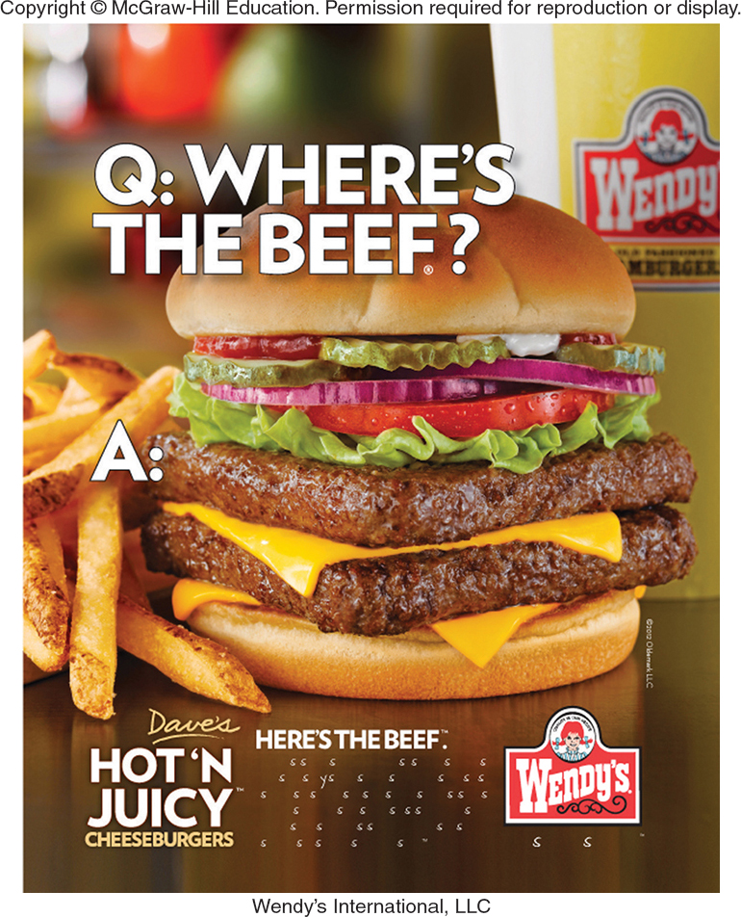
SEGMENTING AND TARGETING MARKETS STEP 3: DEVELOP A MARKET-PRODUCT GRID AND ESTIMATE THE SIZE OF MARKETS
Forming a Market-Product Grid
Estimating Market Sizes

Slide 20
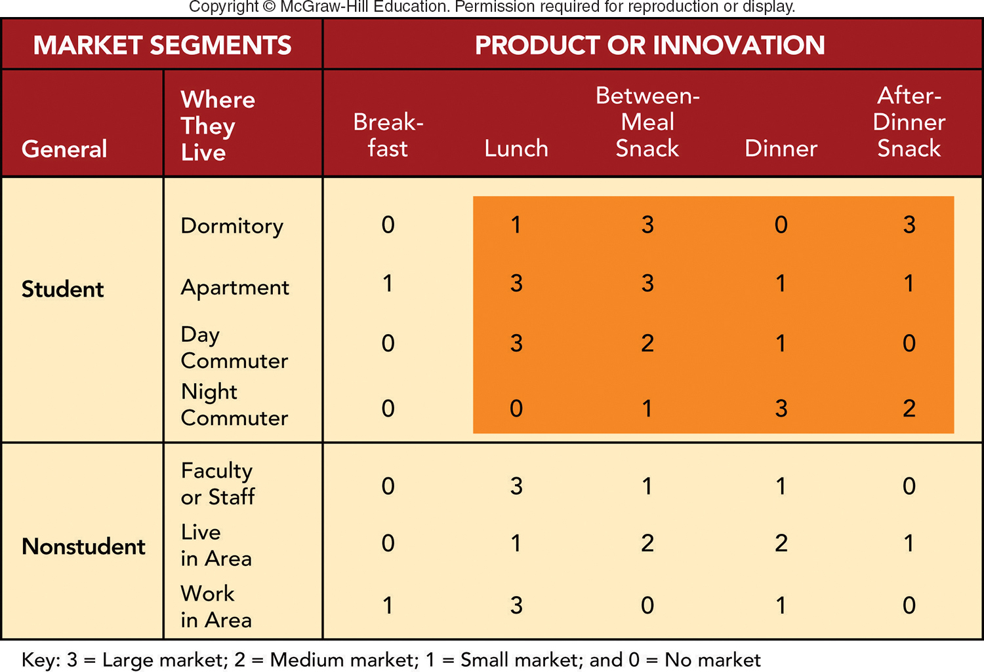
FIGURE 8-6 Selecting a target market for your Wendy’s fast-food restaurant next to an urban university (target market is shaded).
Jump to Appendix 7 long image description

Slide 21
SEGMENTING AND TARGETING MARKETS STEP 4: SELECT TARGET MARKETS (1 of 3)
Criteria to Use in Selecting Target Markets
Two Types of Criteria:
Those That Divide a Market into Segments
Those That Actually Pick the Target Segments

Slide 22
SEGMENTING AND TARGETING MARKETS STEP 4: SELECT TARGET MARKETS (2 of 3)
Criteria to Use in Selecting Target Markets
Market Size
Expected Growth
Competitive Position
Cost of Reaching the Segment
Organizational Compatibility

Slide 23
SEGMENTING AND TARGETING MARKETS STEP 4: SELECT TARGET MARKETS (3 of 3)
Choose the Products and Segments
No Breakfast
Four Student Segments Only
Not the Three Nonstudent Segments

Slide 24
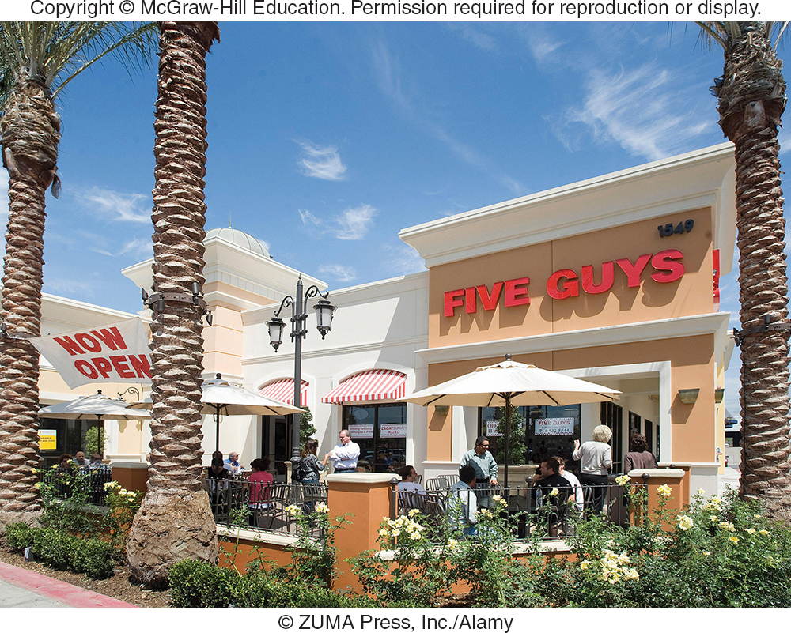
SEGMENTING AND TARGETING MARKETS STEP 5: TAKE MARKETING ACTIONS (1 of 2)
Wendy’s Immediate Segmentation Strategy
Day Commuters
Between-Meal Snacks
Dinners to Night Commuters
Keeping an Eye on Competition
Future Strategies for Wendy’s?

Slide 25
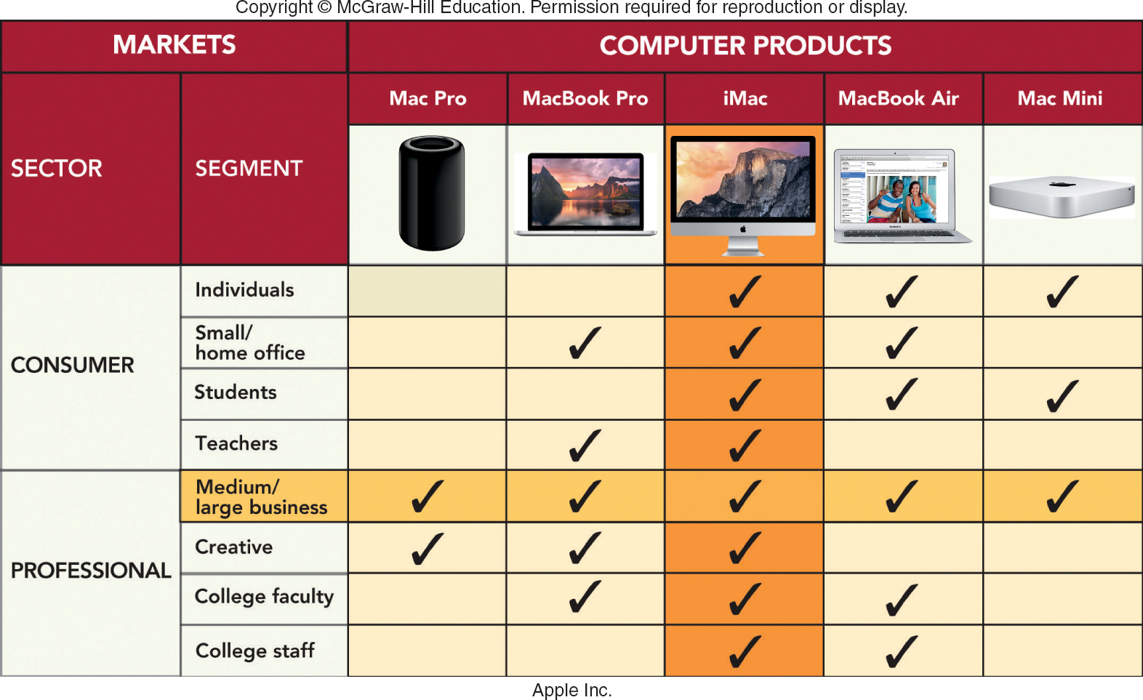
MARKETING MATTERS Apple’s Segmentation Strategy
Jump to Appendix 8 long image description

Slide 26
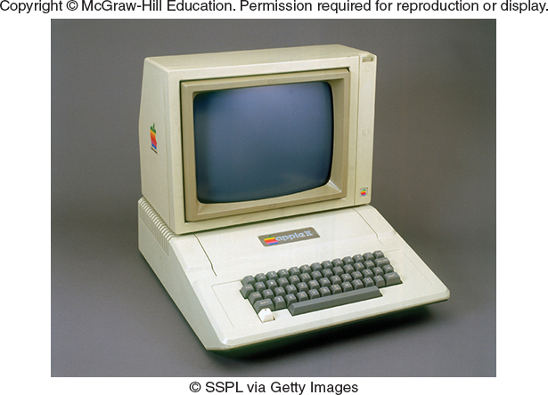
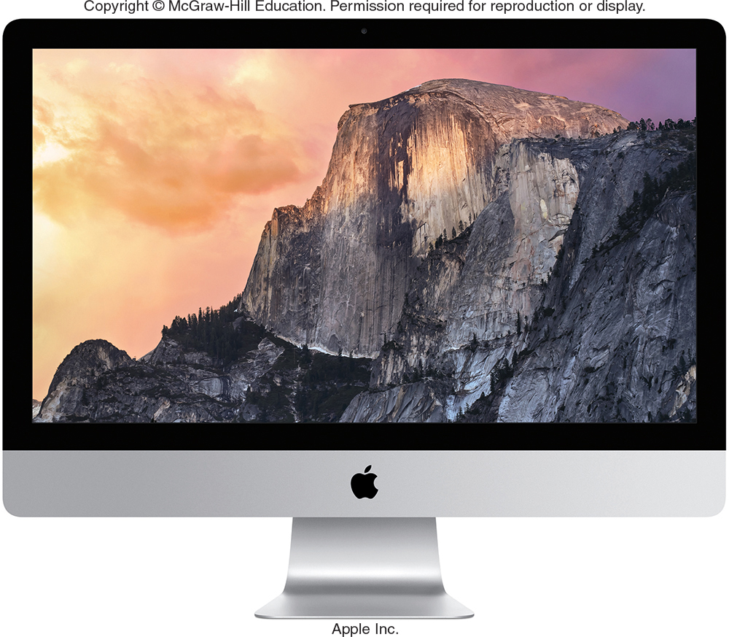
SEGMENTING AND TARGETING MARKETS STEP 5: TAKE MARKETING ACTIONS (2 of 2)
Apple's Ever-Changing Segmentation Strategy
Market-Product Synergies: A Balancing Act
Marketing Synergies
Product Synergies
Apple’s 1984 Super Bowl Ad

Slide 27
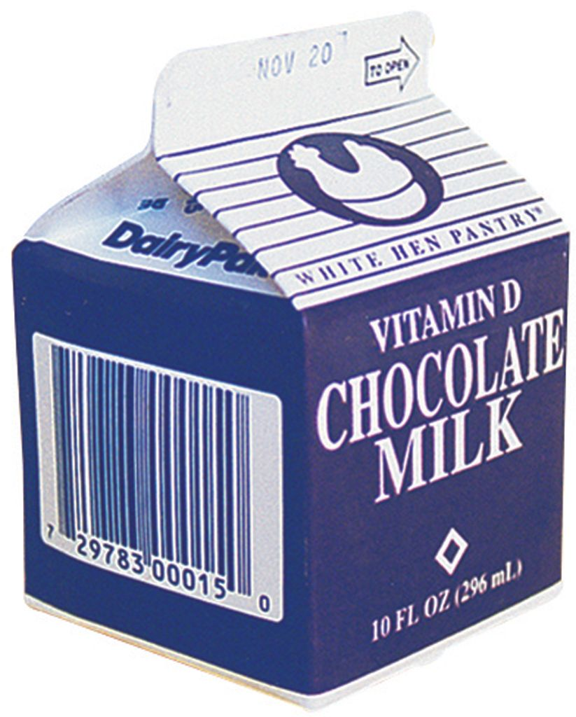
POSITIONING THE PRODUCT (1 of 3)
Product Positioning
Product Repositioning
Two Approaches to Product Positioning
Head-to-Head Positioning
Differentiation Positioning
Crafting a Formal Positioning Statement

Slide 28
POSITIONING THE PRODUCT (2 of 3)
Product Positioning Using Perceptual Maps
Identify Important Attributes for a Product or Brand Class
Customers’ Ratings of Competing Products or Brands on These Attributes
Customers’ Ratings of the Company’s Products or Brands on These Attributes
Reposition the Company’s Products or Brands in the Minds of Consumers

Slide 29
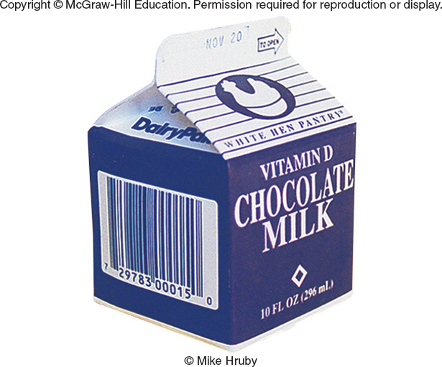
POSITIONING THE PRODUCT (3 of 3)
Perceptual Map
A Perceptual Map to Reposition Chocolate Milk for Adults
Identify Important Attributes for Adult Drinks
Discover How Adults See Competing Drinks
Discover How Customers See Chocolate Milk
Reposition Chocolate Milk to Make It More Appealing to Adults

Slide 30
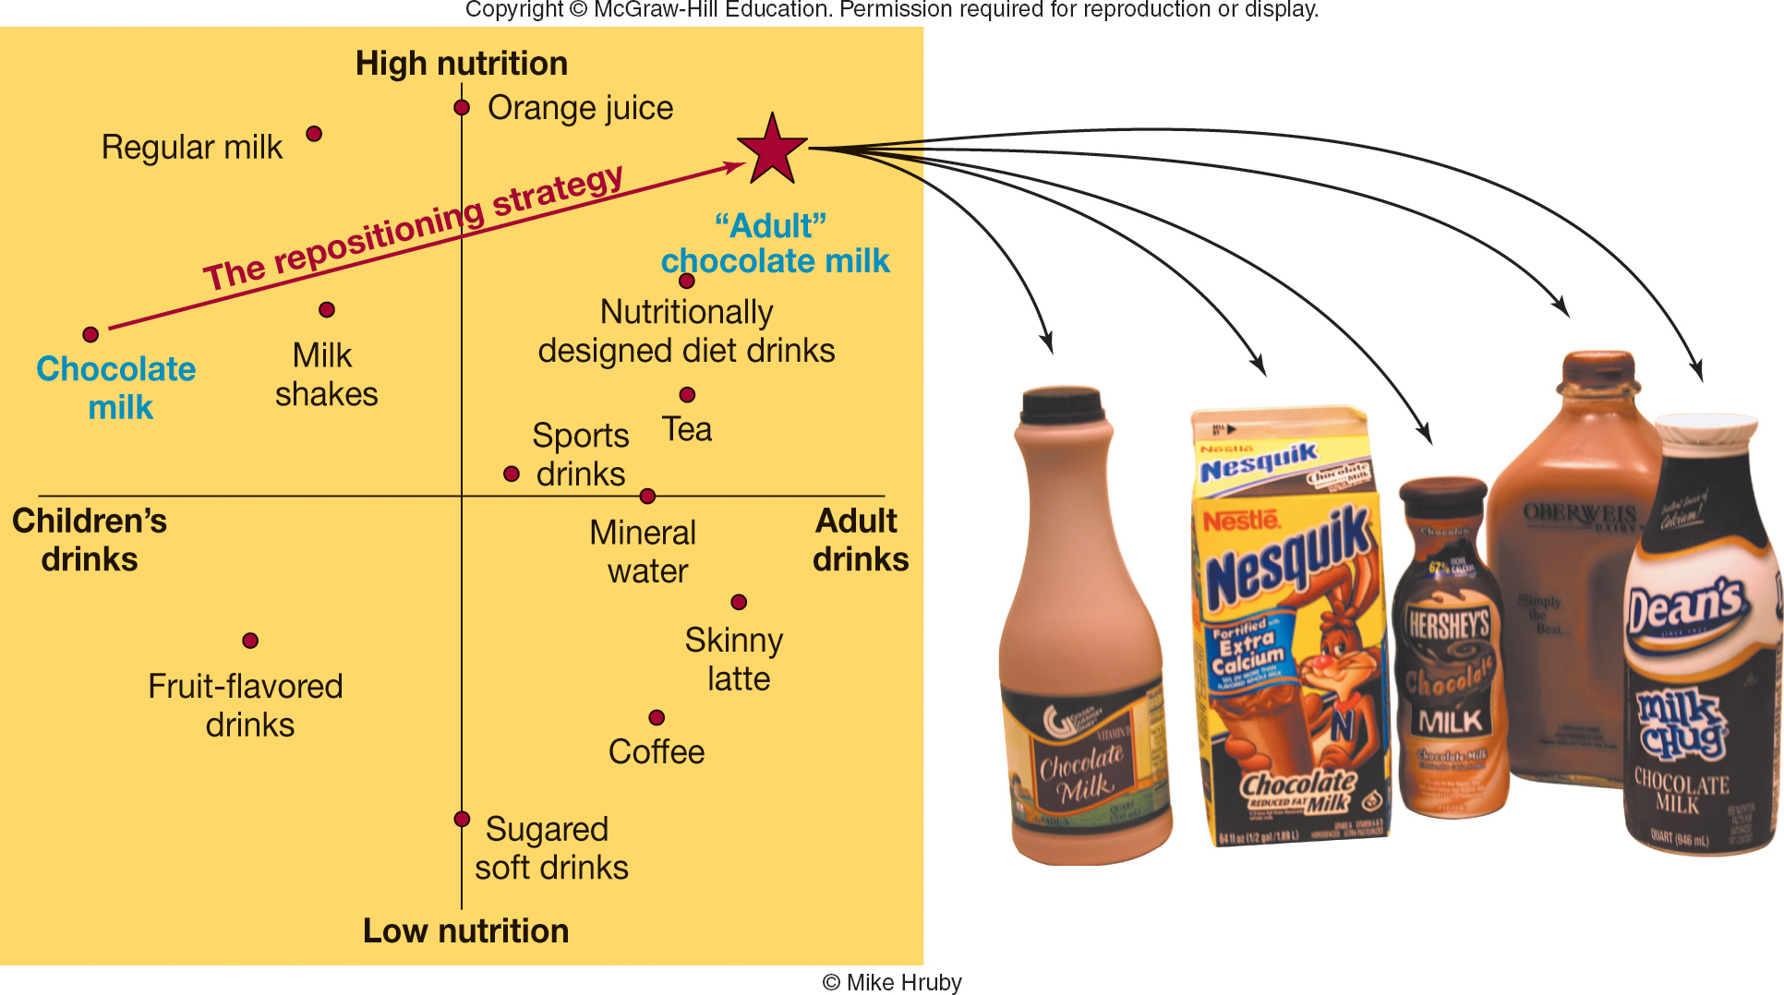
FIGURE 8-7 The strategy American dairies are using to reposition chocolate milk to reach adults.
Jump to Appendix 9 long image description

Slide 31
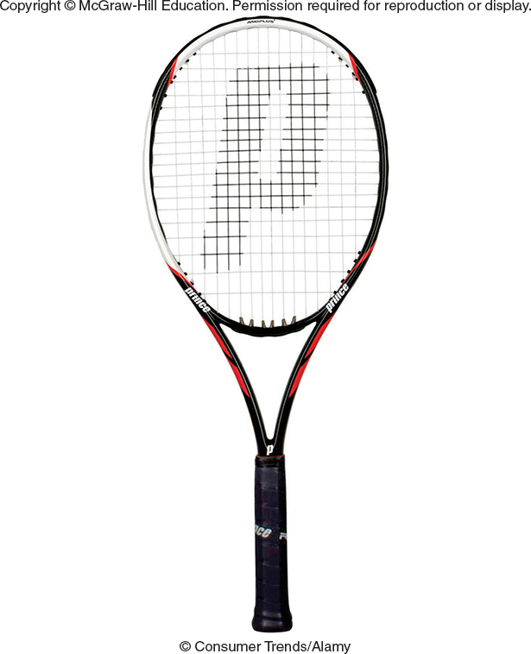
VIDEO CASE 8 PRINCE SPORTS, INC.: TENNIS RACQUETS FOR EVERY SEGMENT
Prince Video Case

Slide 32
FIGURE 1 Prince targets racquets at specific market segments
Main Segments | Subsegment | Characteristics | Brand Name | Length (Inches) | Unstrung Weight (Ounces) | Head Size (Sq. In.)
Performance | Precision | Touring professional players | EXO3 Ignite 95 | 27.0 | 11.8 | 95
 | Thunder | Competitive players | EXO3 Red 95 | 27.25 | 9.9 | 105
Recreational | Small head size | Forgiving racquet with added control | AirO Lightning MP | 27.0 | 9.9 | 100
 | Larger head size | Larger sweet spot and added power | AirO Maria Lite OS | 27.0 | 9.7 | 110
Junior | More experiences young players | Ages 8-15 Shorter and lighter racquet | AirO Team Maria 23 | 23.0 | 8.1 | 100
 | Beginner | Ages 5-11 Much shorter and lighter racquet | Air Team Maria 19 | 19.0 | 7.1 | 82

Slide 33
VIDEO CASE 9 Prince Sports (1 of 5)
In the 21st century, what trends in the environmental forces (social, economic, technological, competitive, and regulatory) (a) work for and (b) work against success for Prince Sports in the tennis industry?

Slide 34
VIDEO CASE 9 Prince Sports (2 of 5)
Because sales of Prince Sports in tennis-related products depends heavily on growth of the tennis industry, what marketing activities might it use in the United States to promote tennis playing?

Slide 35
VIDEO CASE 9 Prince Sports (3 of 5)
What promotional activities might Prince use to reach (a) recreational players and (b) junior players?

Slide 36
VIDEO CASE 9 Prince Sports (4 of 5)
What might Prince do to gain distribution and sales in (a) mass merchandisers like Target and Walmart and (b) specialty tennis shops?

Slide 37
VIDEO CASE 9 Prince Sports (5 of 5)
In reaching global markets outside the U.S., (a) what are some criteria that Prince should use to select countries in which to market aggressively, (b) what three or four countries meet these criteria best, and (c) what are some marketing actions Prince might use to reach these markets?

Slide 38
IN-CLASS ACTIVITY 8-1
HONEY NUT CHEERIOS® MILK ‘N CEREAL BAR: IDENTIFYING PRODUCT GROUPS

Slide 39
ICA 8-1 Honey Nut Cheerios® Milk ‘N Cereal Bar
Discover process of categorization and how different people categorize the same objects in different ways.
Explore some of the reasons for these differences.
Understand the importance of categorization in identifying both market segments and competitors.

Slide 40
IN-CLASS ACTIVITY 8-2
3M POST-IT® FLAG + HIGHLIGHTER: PRODUCT POSITIONING FOR CONSUMERS AND RETAILERS

Slide 41
ICA 8-2 3M Post-it® Flag Highlighter Invention
Study 3M Flag Highlighters
Suggest Consumer Benefits and Retailer Benefits
Compose a Product Positioning Statement that Links it to 3M’s Branding Strategy for the Product
3M Post-it Flag
Highlighter Ad
3M Post-it Flag
Highlighter Website

Slide 42
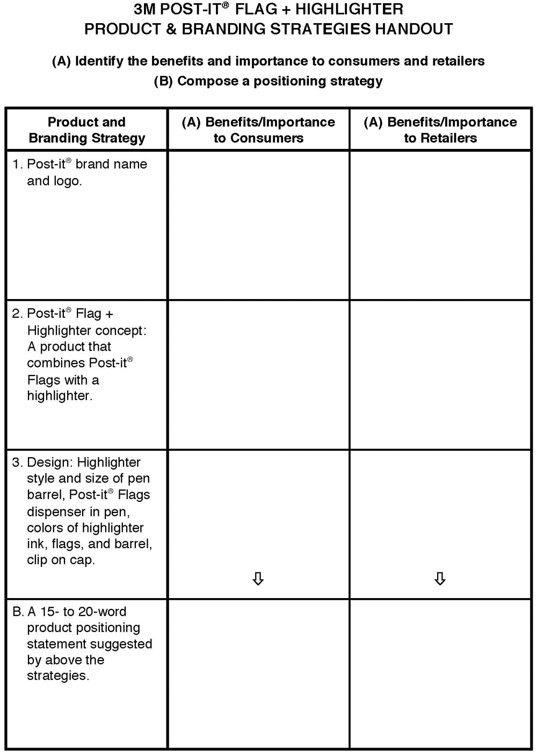
Product and Branding Handout

Slide 43
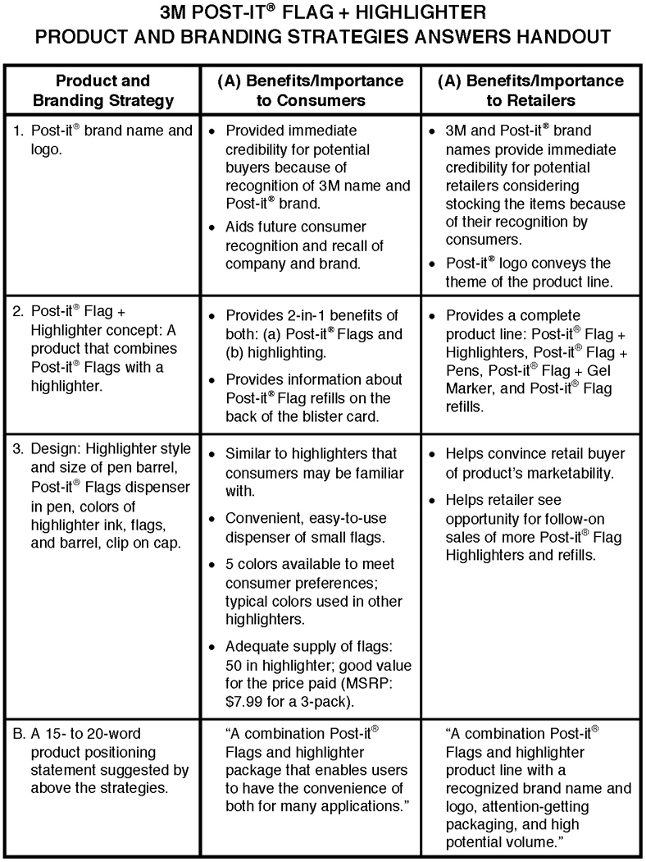
Product and Branding Answers Handout

Slide 44


Market Segmentation
Market segmentation involves aggregating prospective buyers into groups, or segments, that (1) have common needs and (2) will respond similarly to a marketing action.

Slide 45
Product Differentiation
Product differentiation is a marketing strategy that involves a firm using different marketing mix actions to help consumers perceive the product as being different and better than competing products.

Slide 46
Market-Product Grid
A market-product grid is a framework to relate the market segments of potential buyers to products offered or potential marketing actions.

Slide 47
Product Positioning
Product positioning is the place a product occupies in consumers’ minds based on important attributes relative to competitive products.

Slide 48
Product Repositioning
Product repositioning involves changing the place a product occupies in a consumer’s mind relative to competitive products.

Slide 49
Perceptual Map
A perceptual map is a means of displaying in two dimensions the location of products or brands in the minds of consumers to enable a manager to see how they perceive competing products or brands, as well as the firm’s own product or brand.

Slide 50
Usage Rate
Usage rate is the quantity consumed or patronage (store visits) during a specific period. Also called frequency marketing.

Slide 51
80/20 Rule
The 80/20 rule is a concept that suggests 80 percent of a firm’s sales are obtained from 20 percent of its customers.

Slide 52
Appendix 1 FIGURE 8-1 Market segmentation links market needs to an organization’s marketing program through marketing mix actions
The first step in market segmentation is to identify market needs, including benefits in terms of product features, expense, quality, and savings in time and convenience. The second step is linking needs to actions, including take steps to segment and target markets. The third step is execute marketing program actions, including a marketing mix of product, price, promotion, and place (distribution).
Return to slide

Slide 53
Appendix 2 FIGURE 8-2 A market-product grid shows the kind of sleeper that is targeted for each of the bed pillows with a different firmness
Firm pillows are targeted to side sleepers (73 percent), while medium pillows are targeted to back sleepers (22 percent), and soft pillows are targeted to stomach sleepers (5 percent).
Return to slide

Slide 54
Appendix 3 Sporting News Baseball Yearbook What market segmentation strategy is used?
Four issues of Sporting News Baseball Yearbook with different covers. All covers have the headline “Holy Cow! Cubs Win”The first is a close up of an Atlanta Braves player about to catch a ball. The second is a New York Yankees pitcher about to pitch a ball. The third is a Seattle Mariners pitcher in mid-pitch. The fourth is a Toronto Blue Jays batter who has just finished swinging the bat.
Return to slide

Slide 55
Appendix 4 FIGURE 8-3 The five key steps in segmenting and targeting markets that link market needs to a firm’s marketing program
First, market needs must be identified. Then needs must be linked to actions. This is done by the following five steps:
1. Group potential buyers into segments.
2. Group products to be sold into categories.
3. Develop a market-product grid and estimate size of markets.
4. Select target markets.
5. Take marketing actions to reach target markets.
Finally, execute marketing program actions.
Return to slide

Slide 56
Appendix 5 FIGURE 8-4 Comparison of various kinds of users and nonusers for Wendy’s, Burger King, and McDonald’s fast-food restaurants
Wendy's, Burger King, and McDonalds have their patrons broken into user percentages (sole restaurant, primary restaurant, secondary restaurant) and nonusers percentages (prospects, nonprospects).
Wendy's. Sole restaurant 0.7 percent. Primary restaurant 12.5 percent. Secondary restaurant 15.2 percent. Prospects 57.0 percent. Nonprospects 14.6 percent.
Burger King. Sole restaurant 0.7 percent. Primary restaurant 14.7 percent. Secondary restaurant 19.0 percent. Prospects 51.0 percent. Nonprospects 14.6 percent.
McDonald's. Sole restaurant 3.5 percent. Primary restaurant 40.5 percent. Secondary restaurant 15.4 percent. Prospects 26.0 percent. Nonprospects 14.6 percent.
Return to slide

Slide 57
Appendix 6 FIGURE 8-5 Wendy’s new products and innovations target specific market segments based on a customer’s gender, needs, or university affiliation
Nine Wendy's products or innovations are listed: hot n' juicy hamburger (1969), drive-thru (1970), 99 cent super value meals (1989), salad sensations (2002), e-pay (2003), breakfast sandwiches (2007), natural-cut fries with sea salt (2010), Dave's hot 'n juicy hamburgers (2011), and my Wendy's mobile app (2014). Three general market segments, and their smaller groups, are also listed: gender (male, female), needs (price/value, health-conscious, convenience, meat lovers), and university affiliation (affiliated, nonaffiliated).
The table lists the market segments as either the primary market or the secondary market for the Wendy's products and innovations.
Male: Primary - Hot n' Juicy Hamburger. Primary - drive thru. Primary - 99 cent super value meals. Secondary - salads. Primary - e-pay. Primary - breakfast sandwiches. Primary - natural-cut fries with sea salt. Primary - Dave's hot n' juicy hamburgers. Primary - Wendy's mobile app.
Female: Primary - salads. Primary - e-pay. Primary - Wendy's mobile app.
Price/Value: Primary - 99 cent super value meals. Secondary - salads.
Health-conscious: Primary - salads.
Convenience: Secondary - Hot n' Juicy Hamburger. Primary - drive thru. Secondary - salads. Primary - e-pay. Primary - breakfast sandwiches. Secondary - Dave's hot n' juicy hamburgers. Primary - Wendy's mobile app.
Meat lovers: Primary - Hot n' Juicy Hamburger. Primary - 99 cent super value meals. Secondary - breakfast sandwiches. Secondary - natural-cut fries with sea salt. Primary - Dave's hot n' juicy hamburgers.
Affiliated (students, faculty, staff): Primary - Hot n' Juicy Hamburger. Secondary - drive thru. Primary - 99 cent super value meals. Primary - salads. Primary - e-pay. Secondary - breakfast sandwiches. Primary - Dave's hot n' juicy hamburgers. Primary - Wendy's mobile app.
Nonaffiliated (residents, workers): Secondary - Hot n' Juicy Hamburger. Primary - drive thru. Secondary - 99 cent super value meals. Secondary - salads. Secondary - e-pay. Primary - breakfast sandwiches. Secondary - Dave's hot n' juicy hamburgers. Secondary - Wendy's mobile app.
Return to slide

Slide 58
Appendix 7 FIGURE 8-6 Selecting a target market for your Wendy’s fast-food restaurant next to an urban university (target market is shaded)
The grid breaks down the general market segments of student (dormitory, apartment, day commuter, night commuter) and nonstudent (faculty or staff, live in area, work in area). These are compared to five products or innovations (breakfast, lunch, between-meal snack, dinner, after-dinner snack) to determine whether there is a large market, a medium market, a small market, or no market.
Dormitory: breakfast (none), lunch (small), between-meal snack (large), dinner (none), after-dinner snack (large).
Apartment: breakfast (small), lunch (large), between-meal snack (large), dinner (small), after-dinner snack (small).
Day Commuter: breakfast (none), lunch (large), between-meal snack (medium), dinner (small), after-dinner snack (none).
Night Commuter: breakfast (none), lunch (none), between-meal snack (small), dinner (large), after-dinner snack (medium).
Faculty or staff: breakfast (none), lunch (large), between-meal snack (small), dinner (small), after-dinner snack (none).
Live in area: breakfast (none), lunch (small), between-meal snack (medium), dinner (medium), after-dinner snack (small).
Work in area: breakfast (small), lunch (large), between-meal snack (none), dinner (small), after-dinner snack (none).
Return to slide

Slide 59
Appendix 8 MARKETING MATTERS Apple’s Segmentation Strategy
The grid breaks down market sectors into the segments of consumer (individuals, small/home office, students, and teachers) and professional (medium/large business, creative, college faculty, and college staff). These are compared to five computer products (the mac pro, macbook pro, iMac, macbook air, and mac mini) to determine whether there is a market.
Individuals: iMac, macbook air, mac mini.
Small/home office: macbook pro, iMac, macbook air.
Students: iMac, macbook air, mac mini.
Teachers: macbook pro, iMac.
Medium/large business: mac pro, macbook pro, iMac, macbook air, mac mini.
Creative: mac pro, macbook pro, iMac.
College faculty: macbook pro, iMac, macbook air.
College staff: iMac, macbook air.
Return to slide

Slide 60
Appendix 9 FIGURE 8-8 The strategy American dairies are using to reposition chocolate milk to reach adults
Two lines intersect to form four quadrants. The vertical line is labeled high nutrition at the top and low nutrition at the bottom. The horizontal line is labeled children's drinks to the left and adult drinks to the right. Various drink types are plotted across the quadrants.
Adult drinks/high nutrition: orange juice, nutritionally designed diet drinks, sports drinks, tea.
Adult drinks/low nutrition: mineral water, skinny latte, coffee, sugared soft drinks.
Children's drinks/low nutrition: fruit-flavored drinks, sugared soft drinks.
Children's drinks/high nutrition: regular milk, orange juice, milk shakes, chocolate milk.
A line labeled "the repositioning strategy" is drawn from chocolate milk in the children's drinks/high nutrition quadrant to a spot in the adult drinks/high nutrition quadrant labeled "adult" chocolate milk.
Return to slide

